Slide 1
CSE 322
AMBIGUITY IN GRAMMAR
Lecture #26

Slide 2
Ambiguity

Slide 3






leftmost derivation

Slide 4

leftmost derivation

Slide 5
Two derivation trees

Slide 6
The grammar is ambiguous
string
has two derivation trees

Slide 7
The grammar is ambiguous
string
has two leftmost derivations

Slide 8

Definition:
A context-free grammar is ambiguous
if some string has:
two or more derivation trees

Slide 9

In other words:
A context-free grammar is ambiguous
if some string has:
two or more leftmost derivations
(or rightmost)

Slide 10

Why do we care about ambiguity?
take

Slide 11



Slide 12






Slide 13
Correct result:

Slide 14
Ambiguity is bad for programming languages
We want to remove ambiguity

Slide 15
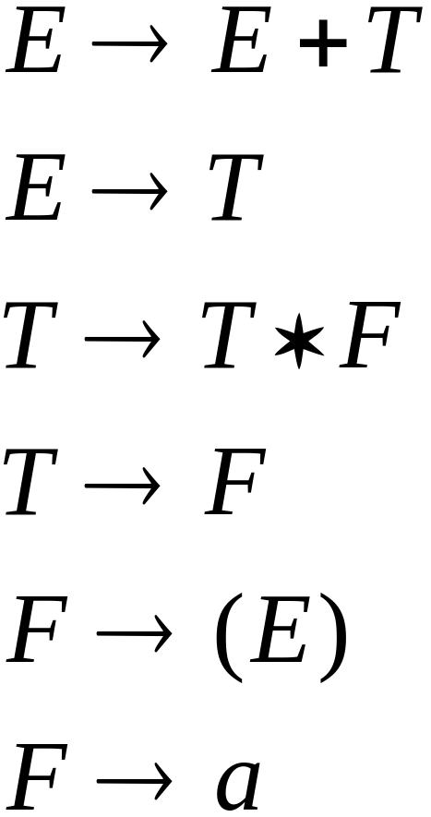
We fix the ambiguous grammar:
New non-ambiguous grammar:

Slide 16
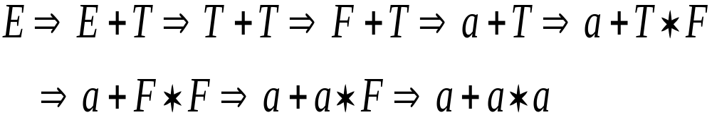



Slide 17
Unique derivation tree

Slide 18
The grammar :
is non-ambiguous:
Every string has
a unique derivation tree

Slide 19
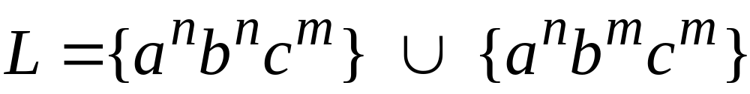

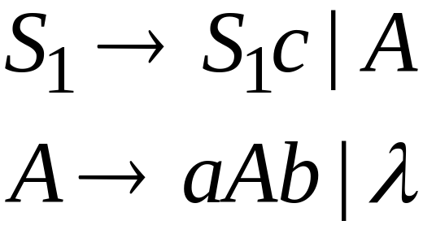
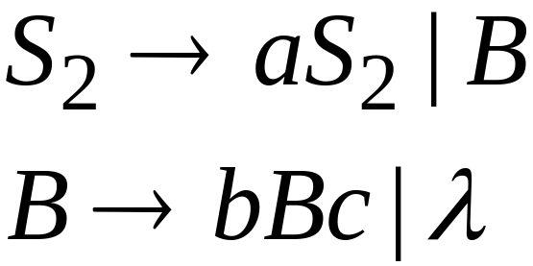
Inherent Ambiguity
Some context free languages
have only ambiguous grammars
Example:

Slide 20
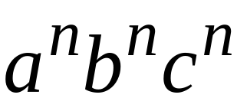




The string has two derivation trees

Slide 21
  Ambiguity in context free grammar
Notes:
Ambiguity in context free grammar

Slide 22
  PROBLEM
Notes:
PROBLEM

Slide 23
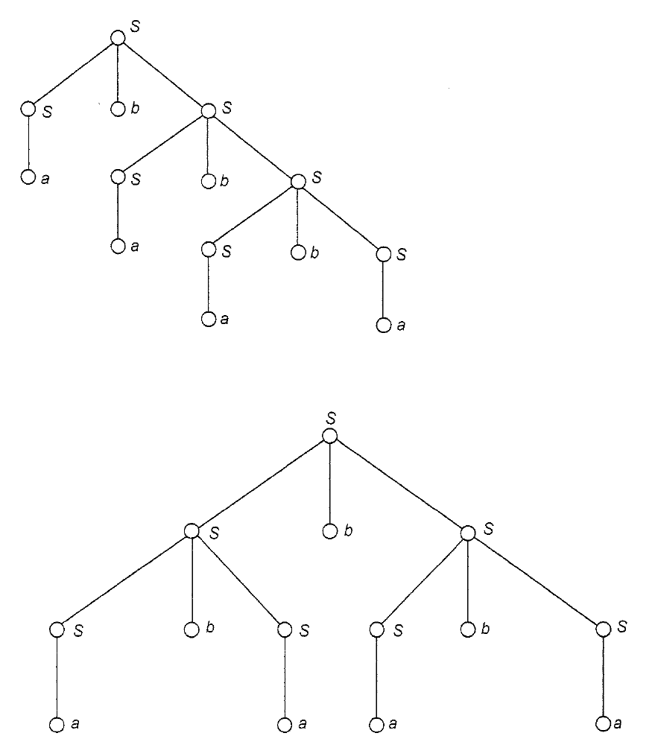
  SOLUTION
Notes:
SOLUTION

